Slide 1


ROYAL UNIVERSITY OF PHNOM PENH
FACULTY OF ENGINEERING
Data Visualization
Advisor
Created by
KOR SOKCHEA
MEANN SEN
NGIN HAK

Slide 2
Contents
What is Data & Graph Visualization?
Objective
Language And Library
Software Flow chart
Regular Expression for Matching Equation
Demo
Conclusion & Future works

Slide 3
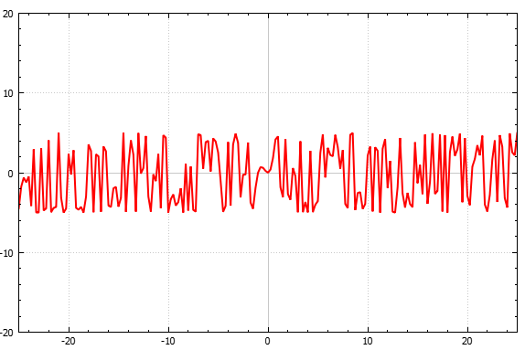
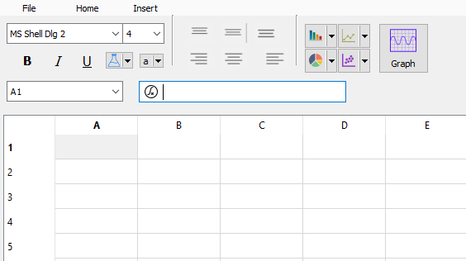
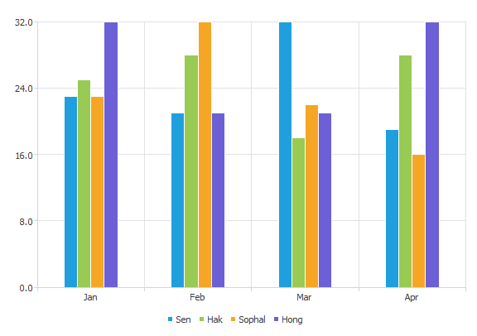
What is Data & Graph Visualization?
Graph Visualization is a program that is similar to Microsoft Excel.
But It has a functionality to plot graph.

Slide 4
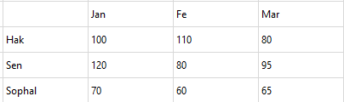
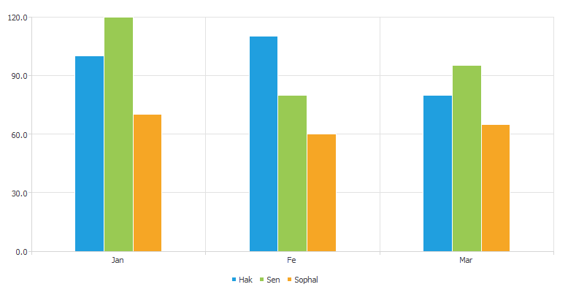
Objective
To visualize a chart from data numbers

Slide 5
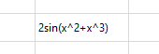
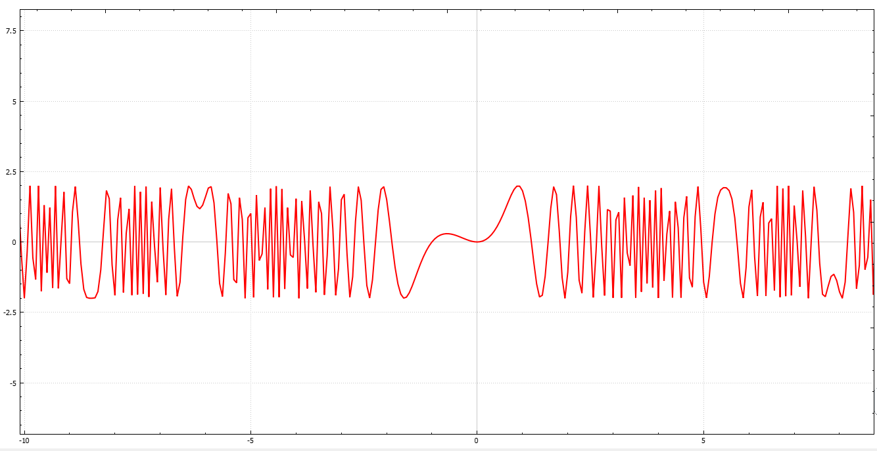
Objective
To visualize a graph from math equation

Slide 6
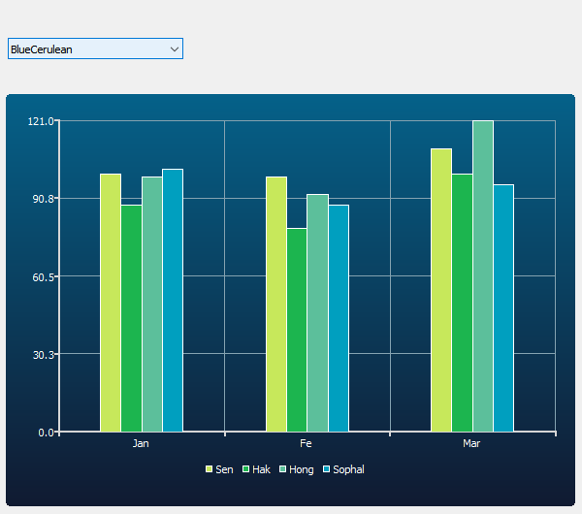
Objective
user’s brain processes information, using charts or graphs to visualize large amounts of complex data is easier than poring over spreadsheets or reports.

Slide 7



Language And Library
This Project developed in
C++ Programming
QT Framework
Regular Expression

Slide 8
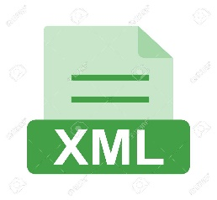

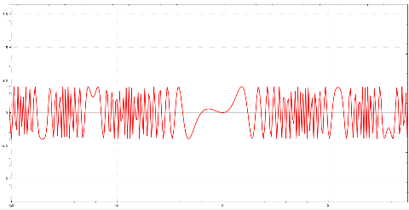
Software Flow chart
Bar Chart
Pie Chart
Input file
Line Chart
XML file
Area Chart
2
3
2
Regular expression
Table
Graph

Slide 9


Regular Expression for Matching Equation
The algorithm to show graph is read equation from the input cell. Firstly, we use Regular Expression to check the equation that it is a right equation or not.
For Example the polynomial equation
Pattern for match equation
$${3x}^{2}+5x$$
$$([+−]?(([0−9]+x\backslash ^[0−9]+)?|([0−9]+x)?|\left( \left[0−9\right]+\right)?|(x)?))$$

Slide 10
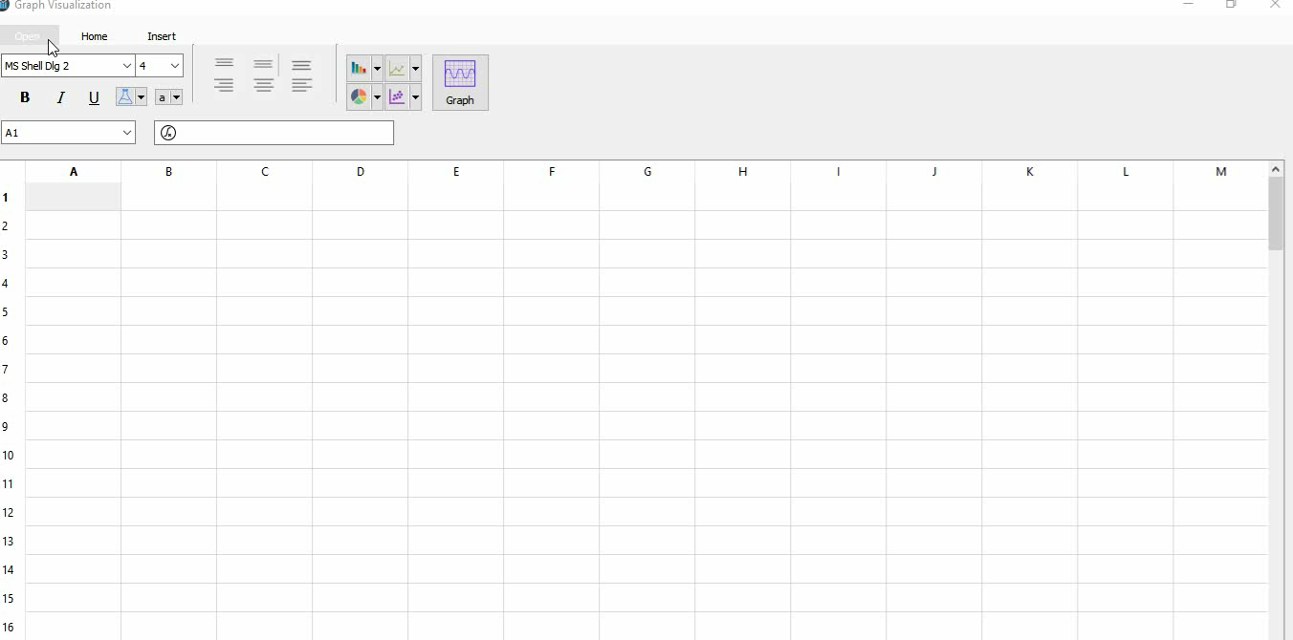
Demo

Slide 11
Conclusion
We have archived two main goals
It can show charts like:
Bar Chart
Pie Chart
Area Chart
Scatter chart
Spline chart
It can plot graphs like:
Polynomial
Sine Wave
Cosine Wave
Logarithm

Slide 12
Future Work
User can be save their result to PDF PNG
Create new extension file
Use formula to calculate data like SUM MEAN MAX MIN

